Slide 1
ECE 4180 Project Presentation IoT Downscaled Home Control System
Joon Kim
Andrew Kahura

Slide 2
Project goals
Develop a home control system with useful functionalities
Develop a system with an easy user experience
End-user might have no technical knowledge/background
Abstract hardware / software

Slide 3
Home control system - feature overview
TIMER AND ALARM: The system will have an alarm that can be configured to ring at a specific time
CLOCK: The clock will display the current eastern time
SMART DISPLAY: uLCD display for a more interactive user experience. Will provide a visual representation of the system's information.
IoT
HOME
CONTROL SYSTEM
TEMP READ: will have a temperature sensor that can read the current room temperature
BLUETOOTH & Ethernet: Interact with the system wirelessly and in a convenient way
Temp trigger: at high temps, user is notified via mobile phone notification.
Pushbutton trigger: turn on desk lamp remotely through system
Figure 1. Control system feature overview

Slide 4
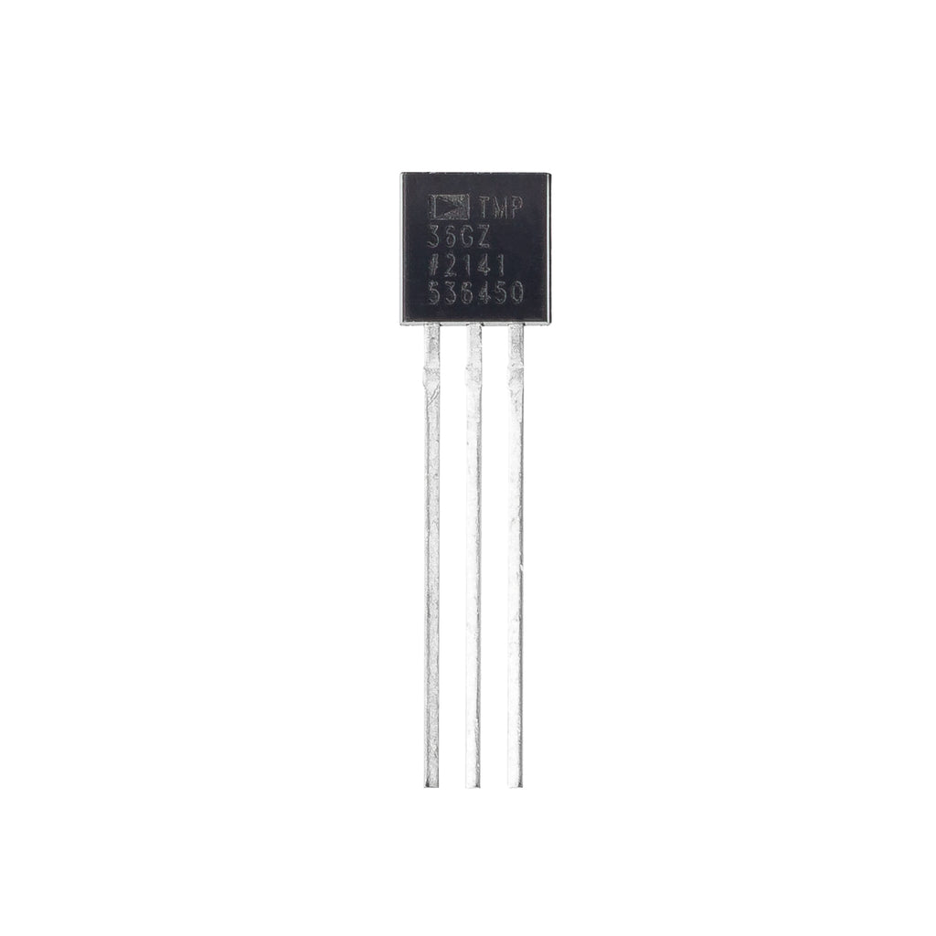
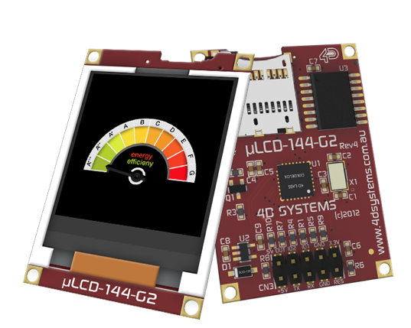
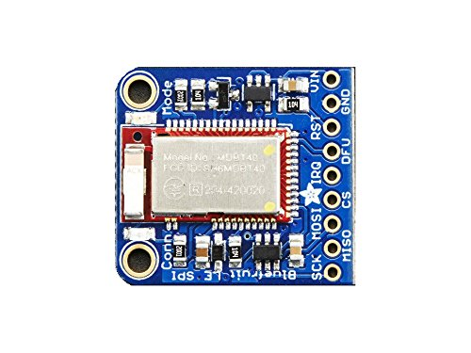
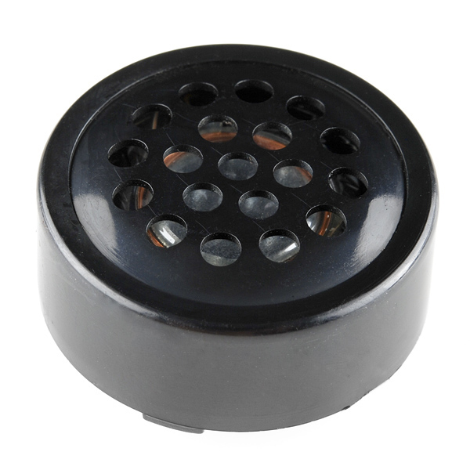
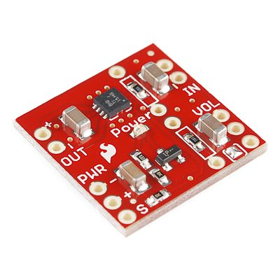
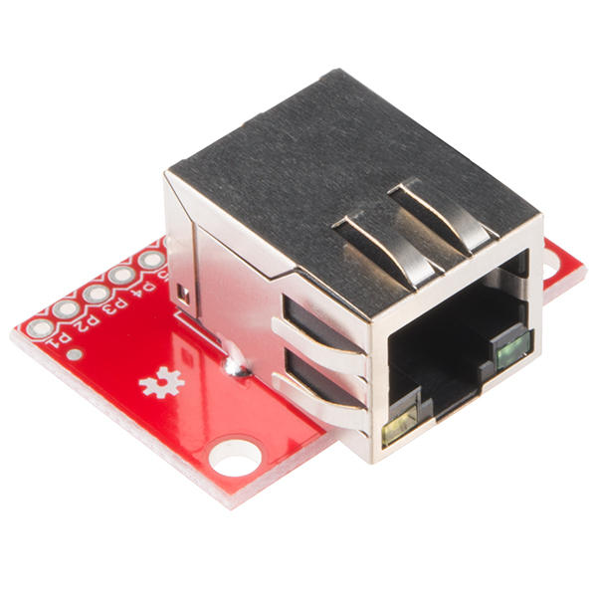
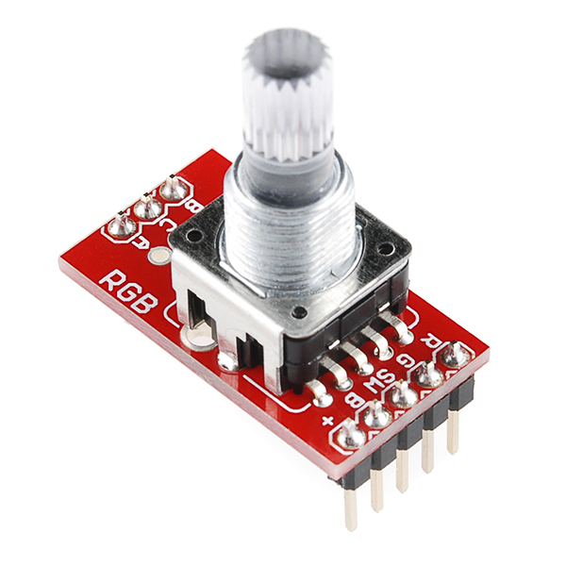
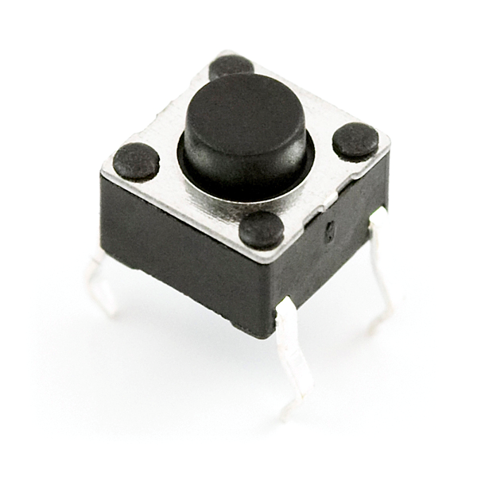
Project components overview
TMP36 Analog Temperature Sensor​
Adafruit Bluetooth module
Speaker & Class D amp
uLCD
Pushbutton
Ethernet breakout board
RBG rotary pulse generator

Slide 5
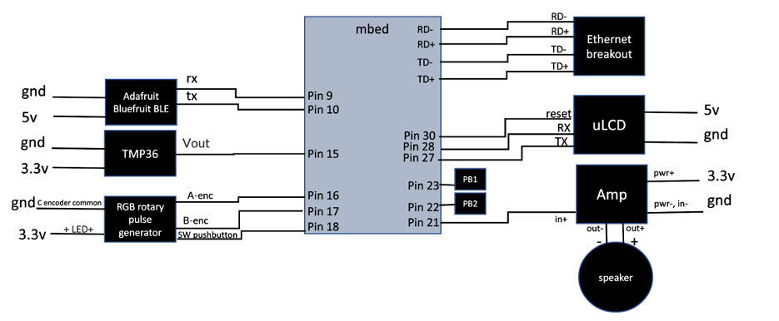
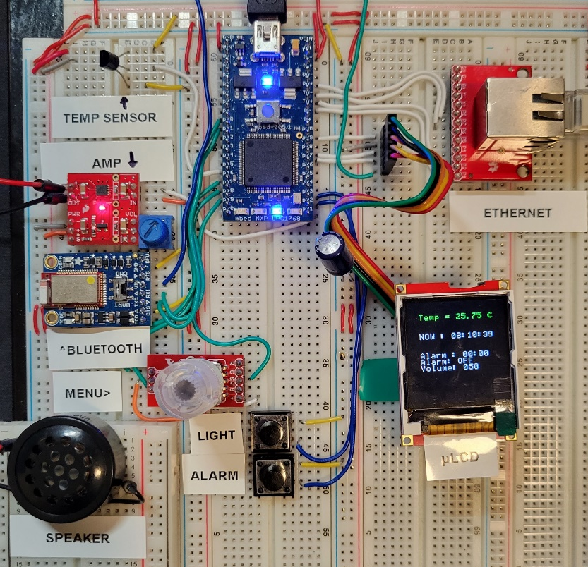
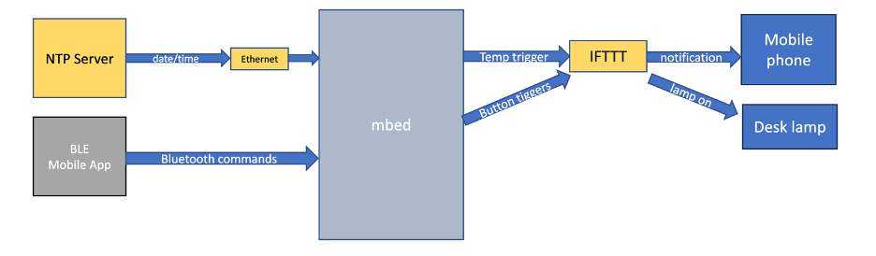
Hardware & Software Architecture
Figure 2. Hardware schematic
Figure 3. Breadboard wiring
IoT Desk Lamp
Figure 4. Software architecture

Slide 6
Conclusion
Robust control system with range of useful features
Interacted with in a meaningful and simple way
Explore additions to improve device
HVAC control
attach motor and fan that automatically turns on when temperature is above a certain value
Voice control to turn an LED light on and off
The EasyVR module, microphone, and cable set
WiFi connection instead Ethernet cable.

